Slide 1


PROJECT MANAGEMENT SYSTEM PROPOSAL

Slide 2

INTRODUCTION
In this modern age, it has become essential for businesses to utilize cutting-edge technologies to maintain a competitive edge in the market. This includes Construction Companies that require robust software solutions to efficiently manage their projects.

Slide 3


PROBLEM
Currently, construction companies are faced with various challenges, such as lack of centralized management systems, manual and time-consuming processes, difficulties in coordinating workers, and difficulties in maintaining client satisfaction.

Slide 4


SOLUTION
We propose to develop a Project Management System (PMS) specifically tailored to address the unique needs of construction companies. This system will incorporate the following features:
Material Management: The PMS will allow users to efficiently manage materials by keeping track of the available inventory.
Worker Management: The system will facilitate the allocation of tasks to workers .
Client Interface: The PMS will offer a user-friendly interface for clients to monitor the real-time progress of their construction projects.

Slide 5
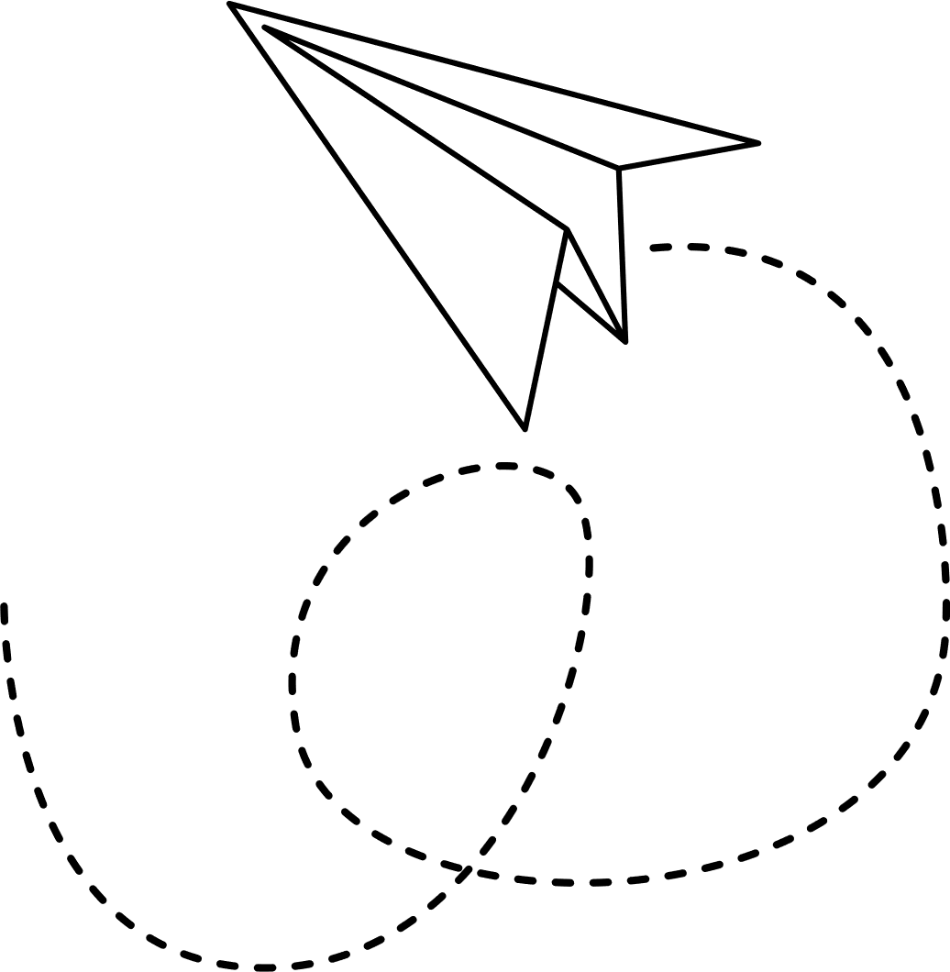

PRODUCT SCOPE
System Architecture: The system will be developed using modern technologies, ensuring reliability and efficiency.
Data Management: The system will accurately track and manage data related to materials, workers, and tasks.
Security: The PMS will implement robust security measures to protect sensitive data and prevent unauthorized access.

Slide 6


BUSINESS MODEL
The system will be developed on a contract basis. The client will have the option to subscribe to the system for a specified period or choose a one-time payment option. The client will be provided with training and technical support to ensure seamless implementation and efficient use of the system.

Slide 7

FEASIBILITY
The proposed system utilizes cutting-edge technologies and development tools, ensuring its technical feasibility.
With a growing number of construction companies seeking innovative software solutions, the market potential for the PMS is significant.
By conducting a thorough market analysis, we can identify and address any potential gaps in the existing software solutions for construction companies.
The proposed system aligns with the company's long-term growth strategy, providing a valuable competitive advantage.
TECHNICAL FEASIBILITY
ECONOMIC FEASIBILITY
COMPETITIVE ANALYSIS
STRATEGIC FIT

Slide 8


THANK YOU!
Prepared by
COHDSE23.1F-012 - K.D.M.Y Perera
COHDSE23.1F-034 - M. A. N. Costa
COHDSE23.1F-068 - K.R. Wijesekara
COHDSE23.1F-069 - H.D.N.S Ranathunga

